Slide 1
Module 4

Slide 2
Understanding neural networks
An Artificial Neural Network (ANN) models the relationship between a set of input signals and an output signal using a model.
Model derived from understanding of how a biological brain responds to stimuli from sensory inputs.
Just as a brain uses a network of interconnected cells called neurons , ANN uses a network of artificial neurons or nodes to solve learning problems.

Slide 3
Applications:-
Speech and handwriting recognition programs
• The automation of smart devices like an office building's environmental controls or self-driving cars and self-piloting drones
• Sophisticated models of weather and climate patterns, tensile strength, fluid dynamics, and many other scientific, social, or economic phenomena
ANNs are versatile learners that can be applied to nearly any learning task: classification, numeric prediction, and even unsupervised pattern recognition.

Slide 4
Artificial neurons
ANNs were intentionally designed as conceptual models of human brain activity.
Incoming signals are received by the cell's dendrites through a biochemical process.
The process allows the impulse to be weighted according to its relative importance or frequency.
As the cell body begins accumulating the incoming signals, a threshold is reached at which the cell fires and the output signal is transmitted via an electrochemical process down the axon.
At the axon's terminals, the electric signal is again processed as a chemical signal to be passed to the neighboring neurons across a tiny gap known as a synapse.

Slide 5
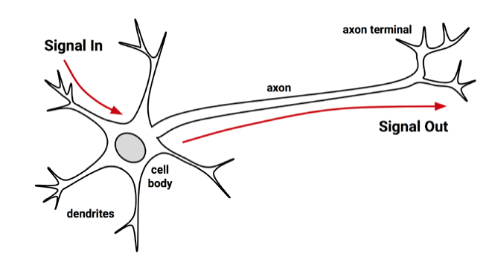

Slide 6
The model of a single artificial neuron can be understood in terms very similar to the biological model
A directed network diagram defines a relationship between the input signals received by the dendrites (x variables), and the output signal (y variable).
Just as with the biological neuron, each dendrite's signal is weighted (w values) according to its importance.
The input signals are summed by the cell body and the signal is passed on according to an activation function denoted by f:

Slide 7
A typical artificial neuron with n input dendrites can be represented by the formula that follows.
The w weights allow each of the n inputs (denoted by xi ) to contribute a greater or lesser amount to the sum of input signals.
The net total is used by the activation function f(x), and the resulting signal, y(x), is the output axon:

Slide 8
Activation functions
An activation function, which transforms a neuron's combined input signals into a single output signal to be broadcasted further in the network.
The activation function is the mechanism by which the artificial neuron processes incoming information and passes it throughout the network.
In the biological case, the activation function could be imagined as a process that involves summing the total input signal and determining whether it meets the firing threshold. If so, the neuron passes on the signal; otherwise, it does nothing. In ANN terms, this is known as a threshold activation function, as it results in an output signal only once a specified input threshold has been attained.

Slide 9
The following figure depicts a typical threshold function; in this case, the neuron fires when the sum of input signals is at least zero. Because its shape resembles a stair, it is sometimes called a unit step activation function.
ANN activation functions can be chosen based on their ability
to demonstrate desirable mathematical characteristics and accurately model relationships among data.

Slide 10
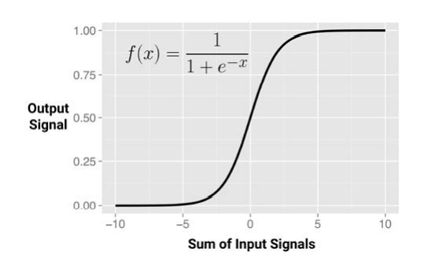
sigmoid activation function( logistic sigmoid).
Here, e is the base of the natural logarithm (approximately 2.72). Although it shares a similar step or "S" shape with the threshold activation function, the output signal is no longer binary; output values can fall anywhere in the range from 0 to 1.

Slide 12
Activation functions gives different output signal range. Typically, this is one of (0, 1), (-1, +1), or (-inf, +inf).
The choice of activation function biases the neural network such that it may fit certain types of data more appropriately, allowing the construction of specialized neural networks.

Slide 13
It's important to recognize that for many of the activation functions, the range of input values that affect the output signal is relatively narrow.
For example, in the case of sigmoid, the output signal is always nearly 0 or 1 for an input signal below -5 or above +5, respectively.
This essentially squeezes the input values into a smaller range of outputs, activation functions like the sigmoid are sometimes called squashing functions.
The solution to the squashing problem is to transform all neural network inputs such that the features' values fall within a small range around 0. Typically, this involves standardizing or normalizing the features.

Slide 14
Network topology
A network topology (or architecture), which describes the number of neurons in the model as well as the number of layers and manner in which they are connected
The topology determines the complexity of tasks that can be learned by the network.

Slide 15
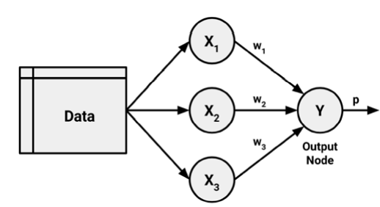
The number of layers
A set of neurons called input nodes receives unprocessed signals directly from the input data. Each input node is responsible for processing a single feature in the dataset; the feature's value will be transformed by the corresponding node's activation function.
The signals sent by the input nodes are received by the output node, which uses its own activation function to generate a final prediction (denoted here as p). The input and output nodes are arranged in groups known as layers.
Because the input nodes process the incoming data exactly as it is received, the network has only one set of connection weights (labeled here as w1 , w2 , and w3 ). It is therefore termed a single-layer network. Single-layer networks can be used for basic pattern classification, particularly for patterns that are linearly separable, but more sophisticated networks are required for most learning tasks.

Slide 16
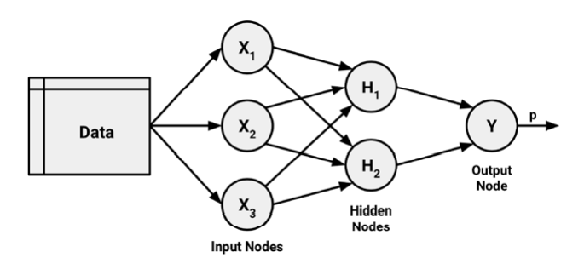
A multilayer network adds one or more hidden layers that process the signals from the input nodes prior to it reaching the output node. Most multilayer networks are fully connected, which means that every node in one layer is connected to every node in the next layer, but this is not required.

Slide 17
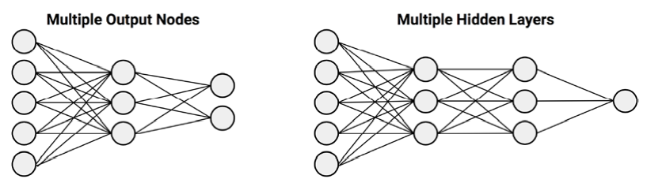
Networks in which the input signal is fed continuously in one direction from connection to connection until it reaches the output layer are called feedforward networks.
Multilayer feedforward network, sometimes called the Multilayer Perceptron (MLP)
A neural network with multiple hidden layers is called a Deep Neural Network (DNN) and the practice of training such network is sometimes referred to as deep learning

Slide 18
In contrast, a recurrent network (or feedback network) allows signals to travel in both directions using loops.
This property, which more closely mirrors how a biological neural network works, allows extremely complex patterns to be learned.
A simple recurrent network is depicted as follows

Slide 19
The number of nodes in each layer
The number of input nodes is predetermined by the number of features in the input data.
Similarly, the number of output nodes is predetermined by the number of outcomes to be modeled or the number of class levels in the outcome.
However, the number of hidden nodes is left to the user to decide prior to training the model. Unfortunately, there is no reliable rule to determine the number of neurons in the hidden layer.
The appropriate number depends on the number of input nodes, the amount of training data, the amount of noisy data, and the complexity of the learning task, among many other factors.

Slide 20
In general, more complex network topologies with a greater number of network connections allow the learning of more complex problems.
A greater number of neurons will result in a model that more closely mirrors the training data, but this runs a risk of overfitting; it may generalize poorly to future data.
Large neural networks can also be computationally expensive and slow to train. The best practice is to use the fewest nodes that result in adequate performance in a validation dataset.

Slide 21
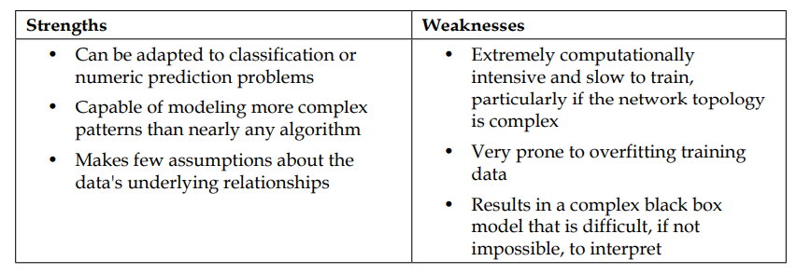
Training neural networks with backpropagation
Training a neural network by adjusting connection weights is very computationally intensive.
An efficient method of training an ANN is backpropagation, which used a strategy of back-propagating errors.
Multilayer feedforward networks that use the backpropagation algorithm are now common in the field of data mining. Such models offer the following strengths and weaknesses:

Slide 22
The backpropagation algorithm iterates through many cycles . Each cycle is known as an epoch.
Because the network contains no a priori (existing) knowledge, the starting weights are typically set at random. Then, the algorithm iterates through the processes, until a stopping criterion is reached.
Each epoch in the backpropagation algorithm includes:
• A forward phase in which the neurons are activated in sequence from the input layer to the output layer, applying each neuron's weights and activation function along the way. Upon reaching the final layer, an output signal is produced.
• A backward phase in which the network's output signal resulting from the forward phase is compared to the true target value in the training data. The difference between the network's output signal and the true value results in an error that is propagated backwards in the network to modify the connection weights between neurons and reduce future errors.

Slide 23
Gradient descent is a technique to determine how much a weight should be changed.
In a similar process, the backpropagation algorithm uses the derivative of each neuron's activation function to identify the gradient in the direction of each of the incoming weights—hence the importance of having a differentiable activation function.
The gradient suggests how steeply the error will be reduced or increased for a change in the weight. The algorithm will attempt to change the weights that result in the greatest reduction in error by an amount known as the learning rate.
The greater the learning rate, the faster the algorithm will attempt to descend down the gradients, which could reduce the training time.

Slide 24
Support Vector Machine Algorithm
Support Vector Machine or SVM is one of the most popular Supervised Learning algorithms, which is used for Classification as well as Regression problems.
Applications:
Classification of microarray gene expression data in the field of bioinformatics to identify cancer or other genetic diseases
• Text categorization such as identification of the language used in a document or the classification of documents by subject matter .
• The detection of rare yet important events like combustion engine failure, security breaches etc.

Slide 25
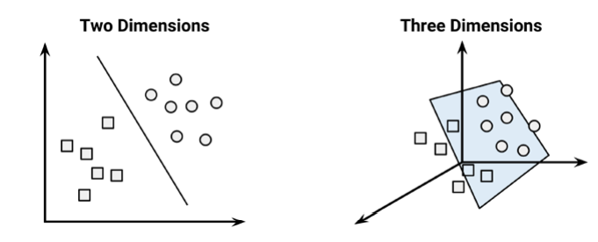
The goal of the SVM algorithm is to create the best line or decision boundary that can segregate n-dimensional space into classes so it is easy put the new data point in the correct category in the future. This best decision boundary is called a hyperplane.
SVMs use a boundary called a hyperplane to partition data into groups of similar class values in two and three dimensions. If the data points can be separated perfectly by the straight line or flat surface, they are said to be linearly separable.

Slide 26
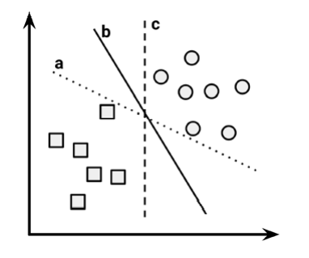
In two dimensions, the task of the SVM algorithm is to identify a line that separates the two classes.
There is more than one choice of dividing line between the groups of circles and squares. Three such possibilities are labeled a, b, and c.

Slide 27
SVM algorithm will choose Maximum Margin Hyperplane (MMH) that creates the greatest separation between the two classes.
Although any of the three lines separating the circles and squares would correctly classify all the data points, it is likely that the line that leads to the greatest separation will generalize the best to the future data.
The maximum margin will improve the chance that, in spite of random noise, the points will remain on the correct side of the boundary.

Slide 28
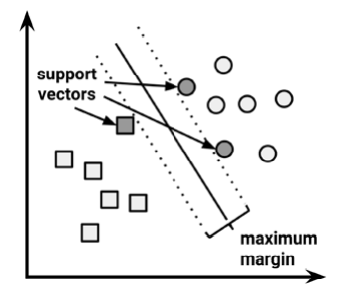
The support vectors are the points from each class that are the closest to the MMH; each class must have at least one support vector, but it is possible to have more than one.
Using the support vectors alone, it is possible to define the MMH. This is a key feature of SVMs; the support vectors provide a very compact way to store a classification model, even if the number of features is extremely large.

Slide 29
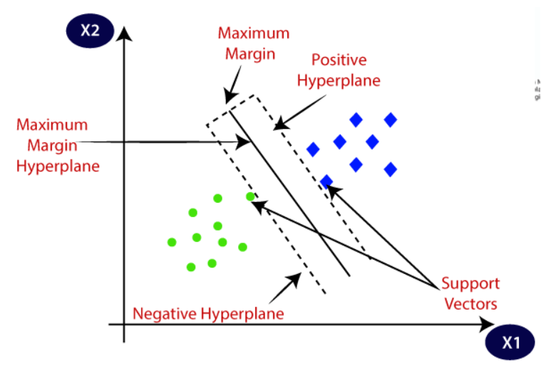

Slide 30
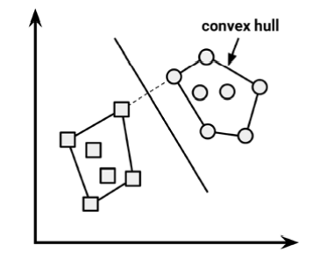
The case of linearly separable data
It is easiest to understand how to find the maximum margin under the assumption that the classes are linearly separable.
In this case, the MMH is as far away as possible from the outer boundaries of the two groups of data points. These outer boundaries are known as the convex hull.
The MMH is then the perpendicular bisector of the shortest line between the two convex hulls.
Sophisticated computer algorithms that use a technique known as quadratic optimization are capable of finding the maximum margin in this way.

Slide 31
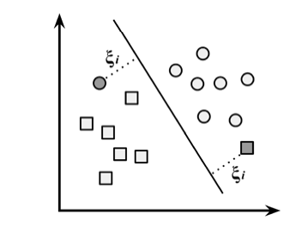
The case of nonlinearly separable data
Non linearly separable means data cannot be separate by straight line.
The solution to this problem is the use of a slack variable, which creates a soft margin that allows some points to fall on the incorrect side of the margin.
The figure that follows illustrates two points falling on the wrong side of the line with the corresponding slack terms

Slide 32
Using kernels for non-linear spaces
In many real-world applications, the relationships between variables are nonlinear.
Slack variable, allows some examples to be misclassified.
A key feature of SVMs is their ability to map the problem into a higher dimension space using a process known as the kernel trick. In doing so, a nonlinear relationship may suddenly appear to be quite linear.

Slide 33
In the following figure, the scatterplot on the left depicts a nonlinear relationship between a weather class (sunny or snowy) and two features: latitude and longitude.
The points at the center of the plot are members of the snowy class, while the points at the margins are all sunny.
Such data could have been generated from a set of weather reports, some of which were obtained from stations near the top of a mountain, while others were obtained from stations around the base of the mountain.
On the right side of the figure, after the kernel trick has been applied, we look at the data through the lens of a new dimension: altitude. With the addition of this feature, the classes are now perfectly linearly separable.

Slide 34
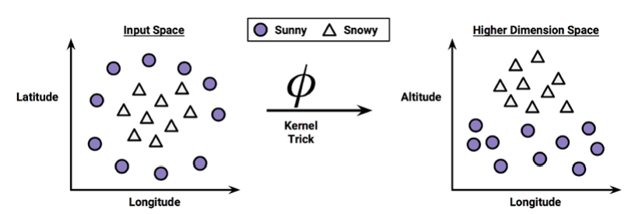

Slide 35
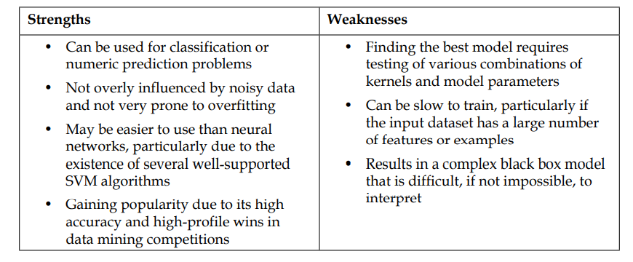
SVMs with nonlinear kernels add additional dimensions to the data in order to create separation.
The kernel trick involves a process of constructing new features that express mathematical relationships between measured characteristics.
SVMs with nonlinear kernels are extremely powerful classifiers.

Slide 36

Kernel functions, in general, are of the following form. The function denoted by the Greek letter phi, that is, ϕ(x), is a mapping of the data into another space.
Therefore, the general kernel function applies some transformation to the feature vectors xi and xj and combines them using the dot product, which takes two vectors and returns a single number.

Slide 37



The linear kernel does not transform the data at all. Therefore, it can be expressed simply as the dot product of the features:
The polynomial kernel of degree d adds a simple nonlinear transformation of the data:
The sigmoid kernel results in a SVM model somewhat analogous to a neural network using a sigmoid activation function. The Greek letters kappa and delta are used as kernel parameters:

Slide 38
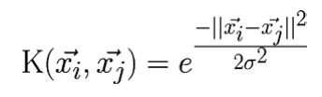
The Gaussian RBF kernel is similar to a RBF neural network. The RBF kernel performs well on many types of data
There is no reliable rule to match a kernel to a particular learning task. The fit depends heavily on the concept to be learned as well as the amount of training data and the relationships among the features. Often, a bit of trial and error is required by training and evaluating several SVMs on a validation dataset.

